Slide 1
Mapping Master
Model Selection
Add New Parameter
Sr.No | Parameter Name | Action
1 | Panoramic sunroof to headliner : 13-23 RH | Delete / Edit
2

Slide 2
Parameter Name – Input Field
1D BIW
1D TCF
Torque
EST
GD
Sr.No | Area | Part | Check Point | Location | Action
1 |  |  |  |  | Add

Slide 3
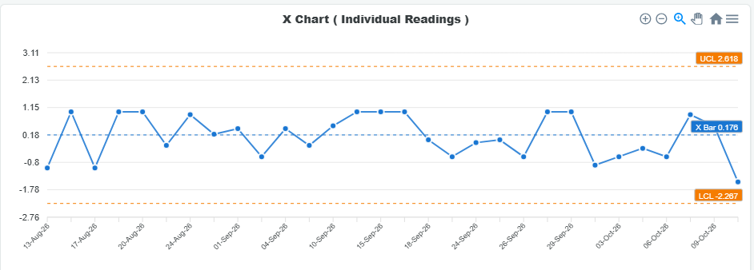
Reports
Date Range
Model
Parameter Name
X Chart
Histogram

